Slide 1
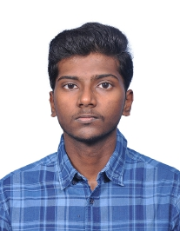
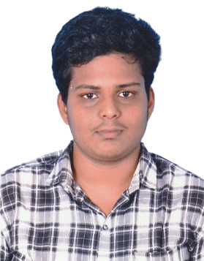
Implementation of Huffman Method (As High As Possible) for ECG Signal in MATLAB
Godwin Sagai V, ECE
Aldrin Infant Raj F, ECE

Slide 2
Outline
Introduction
Problem Statement
Market Survey
Huffman Coding AHAP Algorithm
Flowchart
Mathematical Model
Results and Discussions
Conclusions
References

Slide 3
Introduction
The project addresses the need to compress ECG signals, which are high-volume data often requiring efficient storage and transmission, especially in remote health monitoring.
Huffman coding, a lossless compression algorithm, is an optimal solution to reduce ECG data size without losing accuracy.
This project uses MATLAB to implement Huffman coding, evaluating the compression efficiency and storage savings for a typical ECG signal.

Slide 4
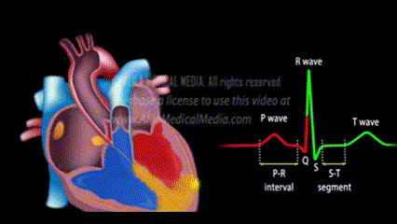
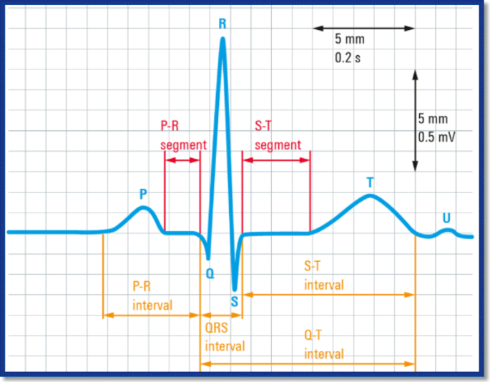
Introduction
What is an ECG Signal?
An ECG (Electrocardiogram) signal is a recording of the heart's electrical activity over time.
It is captured using electrodes placed on the skin to monitor heart health.
The signal typically consists of waves and intervals that represent different phases of the heart’s electrical cycle.

Slide 5
Problem Statement
ECG signals are vital for medical analysis as they reflect the heart's electrical activity.
However, the continuous nature of ECG data results in large storage requirements, which can be problematic for storage and transmission in real-time monitoring applications.
Therefore, an effective transmission technique is required to reduce the data size while preserving critical information.

Slide 6
Market Survey
Wavelet Transform with Huffman Coding: This technique preprocesses ECG signals using Discrete Wavelet Transform (DWT) to segment beats, followed by encoding the wavelet coefficients with Huffman coding. It achieves high compression ratios and maintains signal integrity, making it suitable for real-time applications in wireless ECG devices and Holter monitors.
Modified Run-Length Encoding (RLE):Modified RLE compresses ECG data by encoding sequences of identical values as a single value and count. This method effectively reduces data size while preserving the integrity of long-term ECG recordings, particularly in Holter monitoring systems.
Distributed Source Coding (DSC):DSC exploits redundancy in ECG signals for efficient low-complexity compression, allowing for quick data processing in real-time monitoring scenarios. It significantly enhances data handling by reducing overall size while ensuring quality transmission.
These techniques are actively used in modern medical devices to improve the efficiency of ECG signal processing and transmission.
Digital Communication - Skill based Assessment

Slide 7
Huffman Coding AHAP Algorithm
Data Collection: An ECG signal, represented by sample voltage values, is processed with Huffman coding.
Symbol Extraction and Probability Calculation: Unique ECG signal values (symbols) are identified, and their probabilities are computed.
Huffman Tree Construction: Symbols are used to build a Huffman tree, creating optimal binary codes for each symbol based on frequency.
The ECG data is encoded, and then decoded back.
Digital Communication - Skill based Assessment

Slide 8
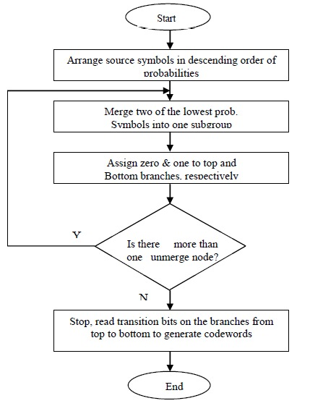
Flowchart
Digital Communication - Skill based Assessment

Slide 9
Mathematical Model
Symbol Si | Probability P(Si) | Stage 1 | Stage 2 | Stage 3 | Codeword | Length L(Si)
S0 | 0.4 | 0.4 | 0.4 | 0.6 | 00 | 2
S1 | 0.2 | 0.2 | 0.4 | 0.4 | 10 | 2
S2 | 0.2 | 0.2 | 0.2 |  | 11 | 2
S3 | 0.1 | 0.2 |  |  | 010 | 3
S4 | 0.1 |  |  |  | 011 | 3
0
1
0
1
0
1
0
1
Digital Communication - Skill based Assessment

Slide 10

Mathematical Model
Average Codeword Length:
Formula:
$$\overline{L_{avg}} = \sum_{i=1}^{N}{P(Si)}×L(Si)$$
Substituting values:
$\overline{L_{avg}}$ = (0.4×2) +(0.2×2) +(0.2×2) +(0.1×3) +(0.1×3)
$\overline{L_{avg}}$ = 0.8+0.4+0.4+0.3+0.3
$\overline{L_{avg}}$ = 2.2 bits / symbol
Digital Communication - Skill based Assessment

Slide 11

Mathematical Model
Entropy:
Formula:
$$H= \sum_{i=1}^{N}{P(Si)\log_{2}\left(\frac{1}{P\left(Si\right)}\right)}$$
Substituting values:
$$H= 0.4\log_{2}\left(\frac{1}{0.4}\right)+ 0.2\log_{2}\left(\frac{1}{0.2}\right)+ 0.2\log_{2}\left(\frac{1}{0.2}\right)+ 0.1\log_{2}\left(\frac{1}{0.1}\right)+ 0.1\log_{2}\left(\frac{1}{0.1}\right)$$
H = 2.1219 bits / Symbol
Digital Communication - Skill based Assessment

Slide 12

Mathematical Model
Coding Efficiency:
$$η=\left(\frac{H}{\overline{L_{avg}} }\right)×100$$
Substituting values:
$$η=\frac{2.1219}{2.2 }×100$$
$$η=96.45\%$$
Digital Communication - Skill based Assessment

Slide 13

Mathematical Model
Variance:
$$σ^{2}= \sum_{i=1}^{N}{P(Si){\left(L\left(Si\right)−\overline{L_{avg}} \right)}^{2}}$$
Substituting values:
$$σ^{2}=0.4{(2−2.2)}^{2}+0.2{(2−2.2)}^{2}+0.2{(2−2.2)}^{2}+0.1{(3−2.2)}^{2}+ 0.1{(3−2.2)}^{2}$$
$$σ^{2}=0.16$$
Digital Communication - Skill based Assessment

Slide 14
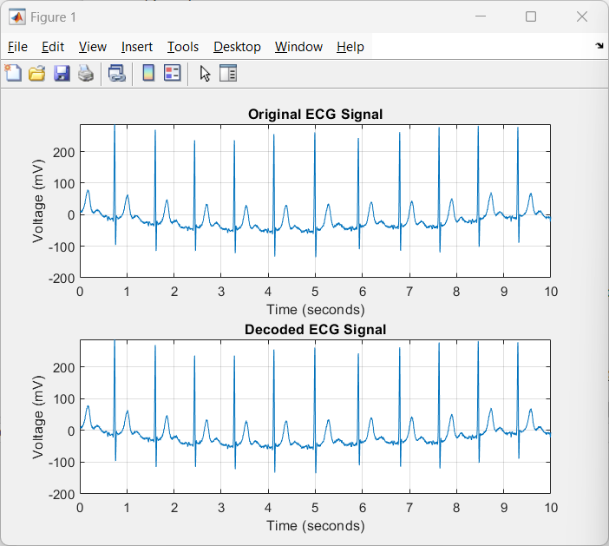
Results and Discussions

Slide 15
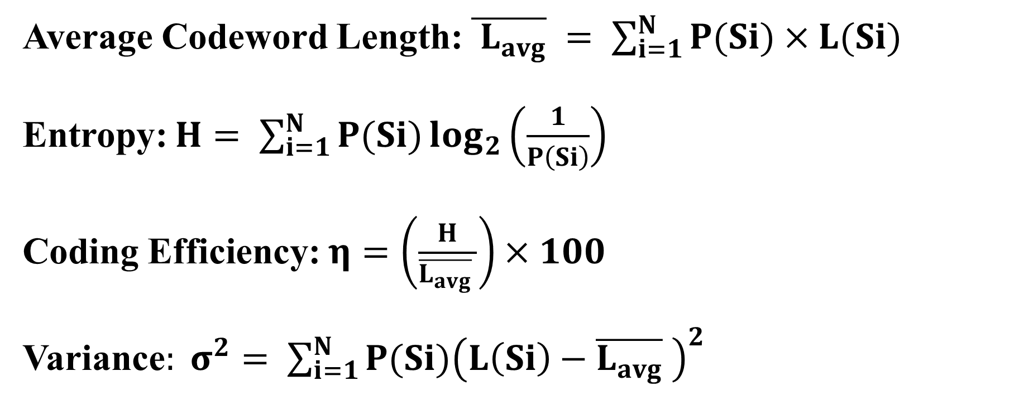
Results and Discussions
Average Codeword Length: $\overline{{ L}_{avg}} = \sum_{i=1}^{N}{P(Si)}×L(Si)$
Entropy: $H= \sum_{i=1}^{N}{P(Si)\log_{2}\left(\frac{1}{P\left(Si\right)}\right)}$
Coding Efficiency: $η=\left(\frac{H}{\overline{L_{avg}} }\right)×100$
Variance$: σ^{2}= \sum_{i=1}^{N}{P(Si){\left(L\left(Si\right)−\overline{L_{avg}} \right)}^{2}}$

Slide 16
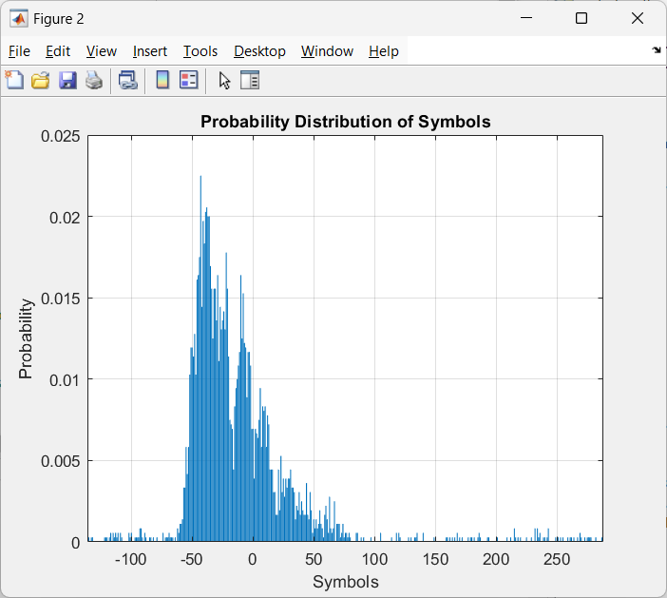
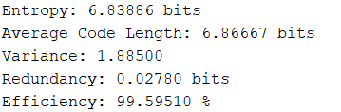
Results and Discussions

Slide 17
Results and Discussions
Input Data taken from PhysioNet
The data comprises 18 long-term recordings of single-lead ECGs and associated 3-axis accelerometer data, collected from 15 subjects (9 female, 6 male) aged between 21 to 83 years. Recordings were carried out between August 2018 and October 2019 while the subjects were undertaking ordinary everyday activities.

Slide 18
Conclusions
The project results showed that Huffman coding achieves a high compression rate while maintaining the original signal quality, making it a valuable tool for managing large amounts of ECG data in healthcare applications.
Digital Communication - Skill based Assessment

Slide 19
References
https://ieee-dataport.org/documents/ecg-signals-744-fragments
https://physionet.org/content/butqdb/1.0.0/100001/#files-panel
Digital Communication - Skill based Assessment

Slide 20
Thank You
Digital Communication - Skill based Assessment

